Slide 1
Map Reduce 2 Other Algorithms using MR
Big Data Analytics - Module 3

Slide 2
OVERVIEW OF THE CHAPTER
Algorithms Using MapReduce:
Matrix-Vector Multiplication by MapReduce
Relational-Algebra Operations, Computing Selections by MapReduce, Computing Projections by MapReduce, Union, Intersection, and Difference by MapReduce, Computing Natural Join by MapReduce, Grouping and Aggregation by MapReduce
Matrix Multiplication, Matrix Multiplication with One MapReduce Step .
Illustrating use of MapReduce with use of real life databases and applications.

Slide 3
SORTING
The standard MR framework automatically sorts the output keys as part of its processing.
So if your Mapper just takes the input key and outputs the same key (with no value), and the Reducer just takes the input keys and outputs them unchanged, you'll end up with all of the keys sorted.
let's suppose you're sorting a really long list of names that all start with an English letter A - Z.
Each mapper gets one name at a time. It looks at the first letter and send the name to the reducer based on that letter. So, all of the 'A's get sent to Reducer 1, and so on
Then each Reducer sorts the names it gets (using any sorting algorithm) - and that should be relatively fast since each one only has so do roughly 1/26 of the data.
When you're done, you'd end up with 26 files, one for each reducer, each in sorted order. You could then concatenate the files in order to get the complete sorted list.

Slide 4
SORTING
The standard MR implementation essentially does a sorting automatically - the "shuffle" phase takes the output keys from the mappers and distributes them to the appropriate reducers according to the key's sorted order, & then sorts the reducer output as it's produced.
Further if we require to sort values instead of keys, one trick is to use entire value (k,V) as key outputted by the Mapper
The reducer will automatically output a sorted list.

Slide 5
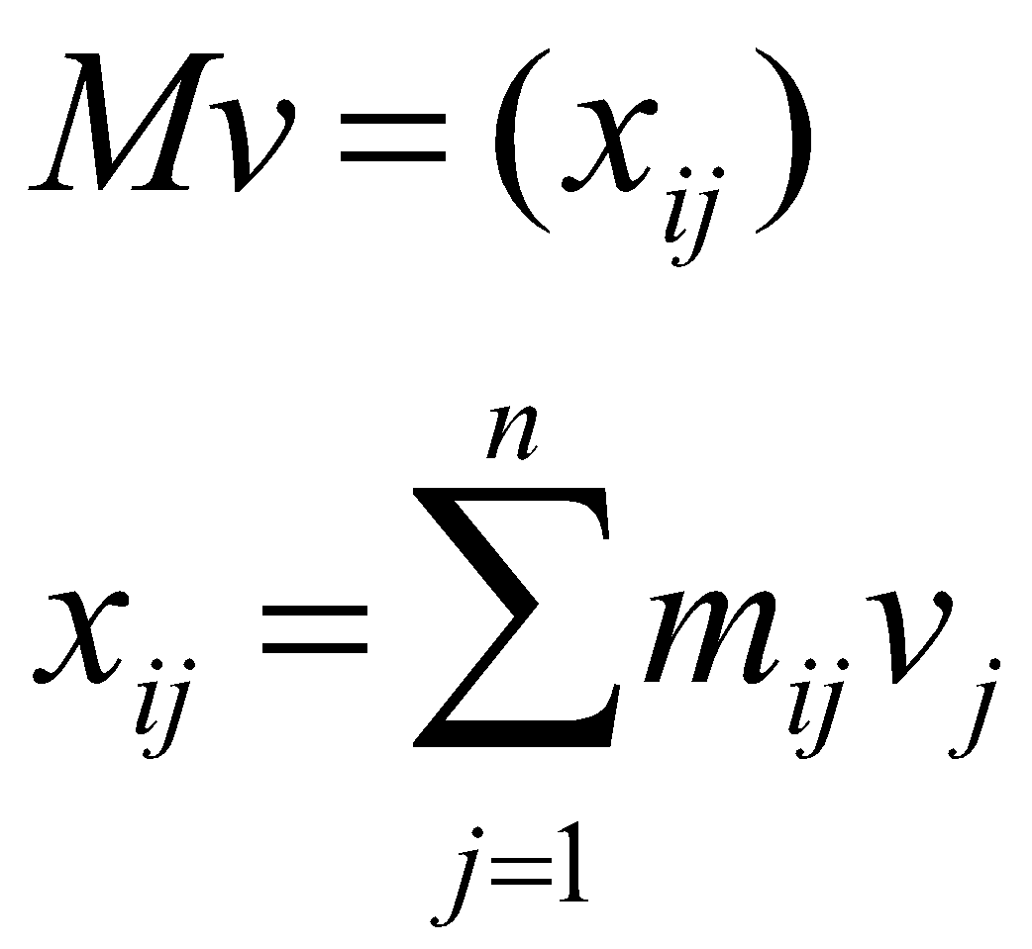
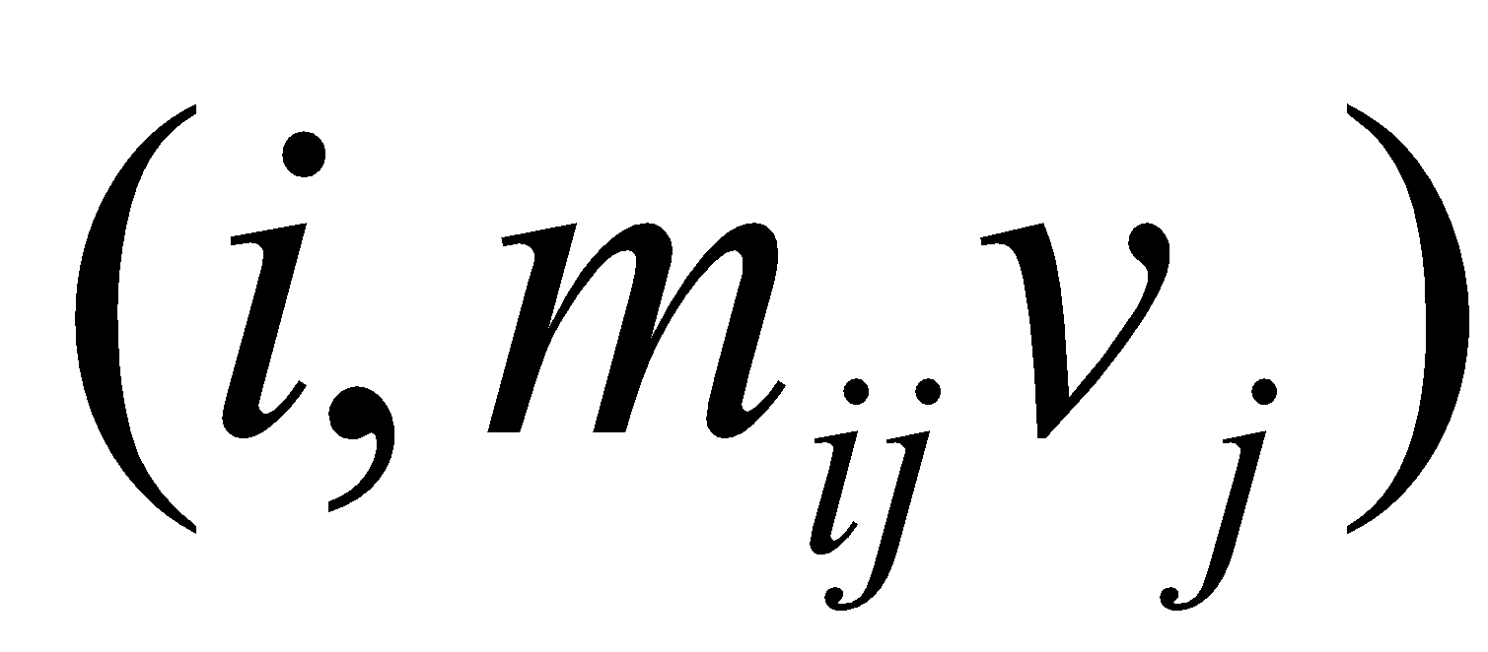

MATRIX – VECTOR MULTIPLICATION
Multiply M = (m_{ij}) (n × n matrix) & v = (v_{i}) (n-vector)
n X n
M
v
n
Case 1: Large n, M does not fit into main memory, but v does
Since v fits into main memory, v is available to every map task
Map: for each matrix element m_{ij}, emit key value pair (i, m_{ij}v_{j})
Shuffle and sort: groups all m_{ij}v_{j} values together for the same i
Reduce: sum m_{ij}v_{j} for all j for the same i

Slide 6
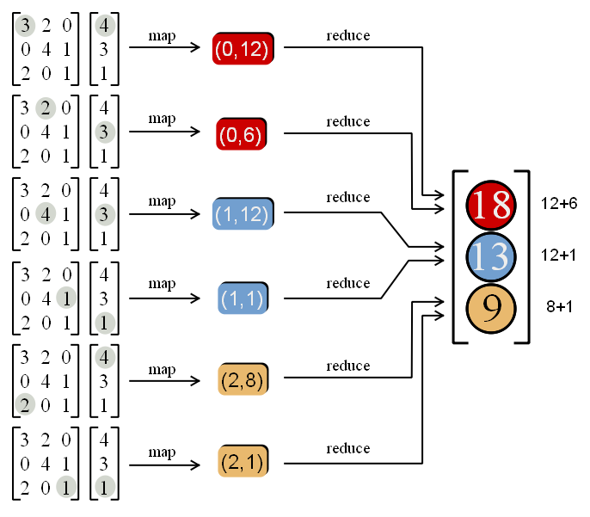

Slide 7
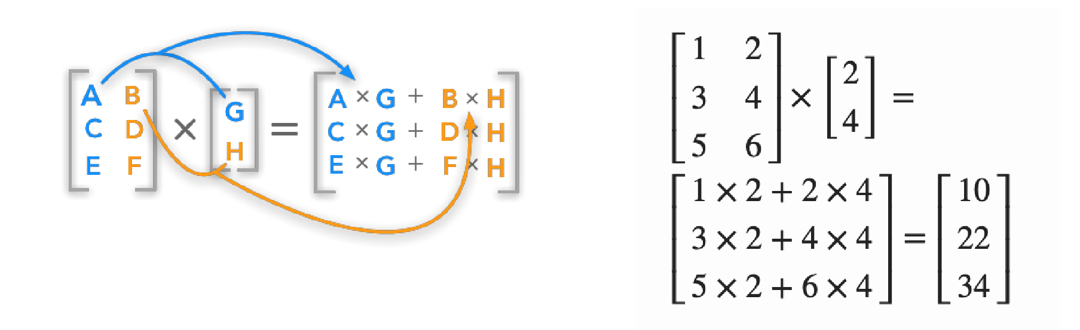

Slide 8
Color = stripe.
Each stripe of matrix divided up
into chunks.
chunk
X

Slide 9
MATRIX – VECTOR MULTIPLICATION
This much will fit into main memory
This whole chunk does not fit in main memory anymore
Case 2: Very large n, even v does not fit into main memory
For every map, many accesses to disk (for parts of v) required!
Solution:
How much of v will fit in?
Partition v and rows of M so that each partition of v fits into memory
Take dot product of one partition of v and the corresponding partition of M
Map and reduce same as before

Slide 10
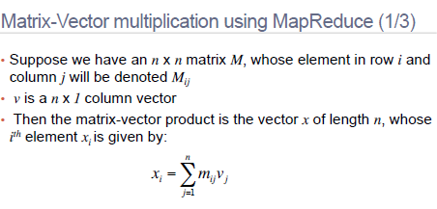

Slide 11
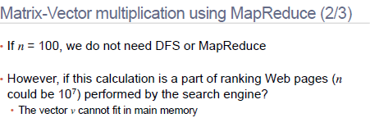
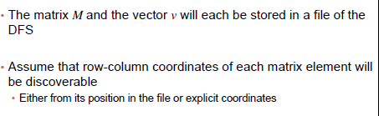

Slide 12
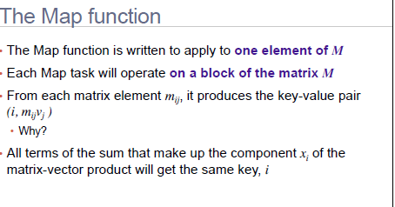
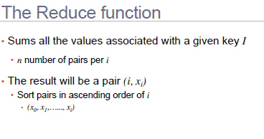

Slide 13
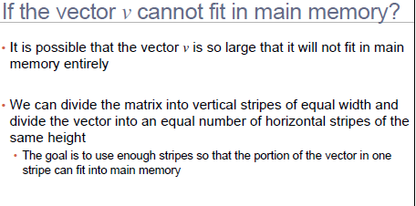

Slide 14
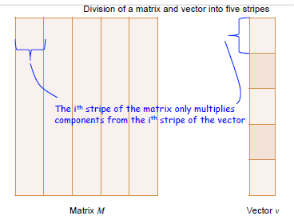

Slide 15
MATRIX-VECTOR MULTIPLICATION MR CODE
map(key, value):
for (i, j, a_ij) in value:
emit(i, a_ij * v[j])
reduce(key, values):
result = 0
for value in values:
result += value
emit(key, result)
communication cost of Map O(mn + n)
communication cost of Reduce O(mn)

Slide 16
RELATIONAL ALGEBRA
Primitives
Projection (π)
Selection (σ)
Cartesian product (×)
Set union (∪)
Set difference (−)
Rename (ρ)
Other operations
Join (⋈)
Group by… aggregation
…

Slide 17
RELATIONAL ALGEBRA
R, S - relation
t, t’ - a tuple
C - a condition of selection
A, B, C - subset of attributes
a, b, c - attribute values for a given subset of attributes
Relations (however big) can be stored in a distributed filesystem – If they don’t fit in a single machine, they’re broken into pieces (think HDFS)

Slide 18
Relational Databases Vs. MapReduce
Relational databases:
Multipurpose: analysis and transactions; batch and interactive
Data integrity via ACID transactions
Lots of tools in software ecosystem (for ingesting, reporting, etc.)
Supports SQL (and SQL integration, e.g., JDBC)
Automatic SQL query optimization
MapReduce (Hadoop):
Designed for large clusters, fault tolerant
Data is accessed in “native format”
Supports many query languages
Programmers retain control over performance
Open source

Slide 19

Selection Using Mapreduce
Map: For each tuple t in R, test if t satisfies C. If so, produce the key-value pair (t, t).
Reduce: The identity function. It simply passes each key-value pair to the output.
R₁
R₂
R₁
R₃
R₃
R₄
R₅

Slide 20
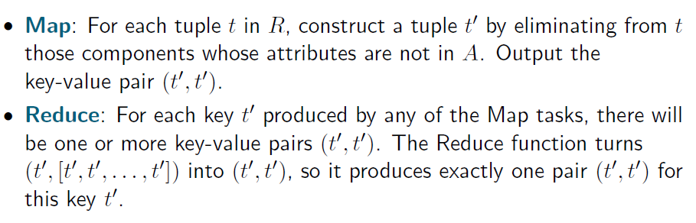

PROJECTION
R₁
R₁
R₂
R₂
R₃
R₃
R₄
R₄
R₅
R₅

Slide 21
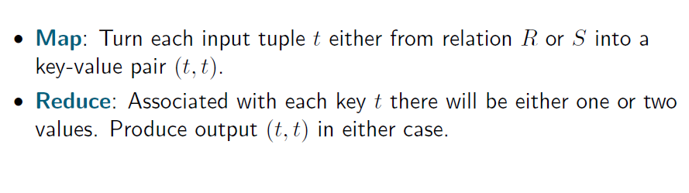
Union Using Mapreduce
Suppose R and S have the same schema
Map tasks are generated from chunks of both R and S

Slide 22
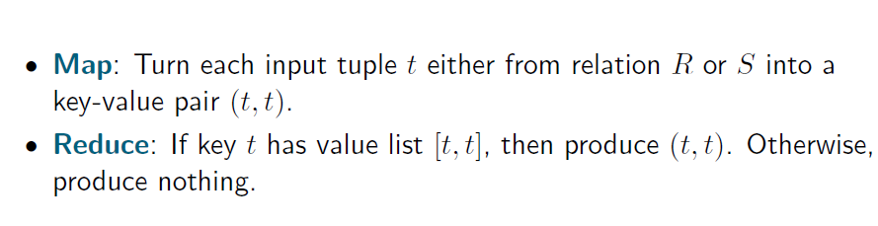
INTERSECTION (R ∩ S)

Slide 23
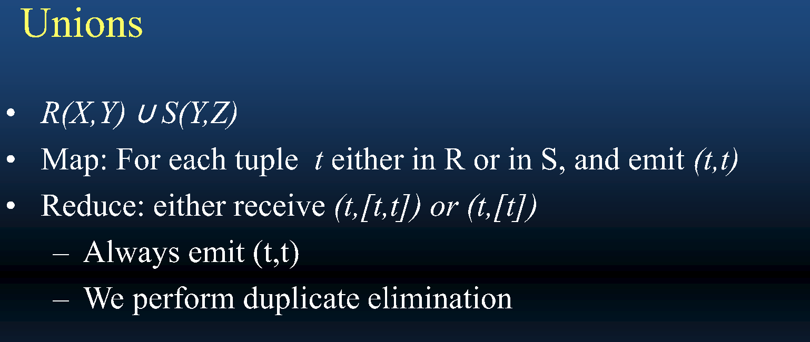
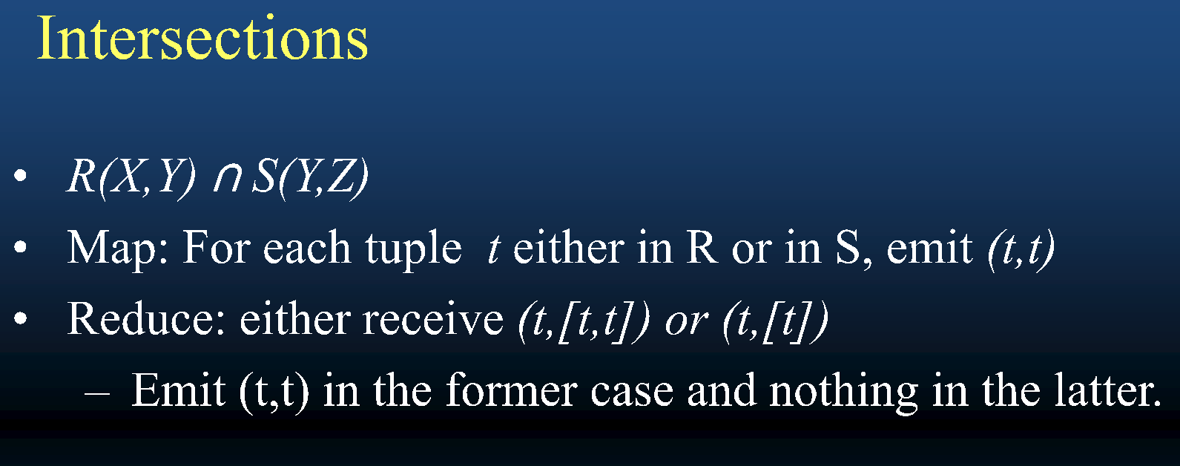

Slide 24
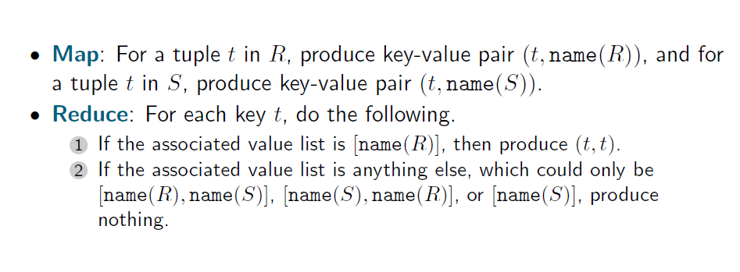
DIFFERENCE (R-S)

Slide 25
GROUPING AND AGGREGATION USING MAPREDUCE
R
Group and aggregate on a relation R(A,B) using aggregation function γ(B), group by attribute A
Map:
For each tuple t = (a,b) of R, emit key value pair (a,b)
Reduce:
For all group {(a,b₁), …, (a,b_{m})} represented by a key ‘a’, apply γ to obtain b_{a} = b₁ + … + b_{m}
Output (a,b_{a})
A | B
x | 2
y | 1
z | 4
z | 1
x | 5
select A, sum(B) from R group by A;
A | SUM(B)
x | 7
y | 1
z | 5

Slide 26
MAP-REDUCE EXAMPLE: AGGREGATION
Compute Avg of B for each distinct value of A
 | A | B | C
R1 | 1 | 10 | 12
R2 | 2 | 20 | 34
R3 | 1 | 10 | 22
R4 | 1 | 30 | 56
R5 | 3 | 40 | 17
R6 | 2 | 10 | 49
R7 | 1 | 20 | 44
Reducer 1
(1, 10)
(2, 20)
(1, 10)
(1, [10, 10, 30, 20])
MAP 1
(1, 17.5)
Reducer 2
MAP 2
(1, 30)
(3, 40)
(2, 10)
(1, 20)
(2, 10)
(3, 40)
(2, 15)
(3, 40)

Slide 27
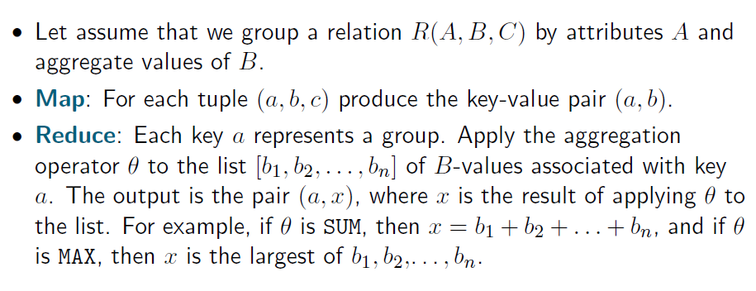
Grouping & Aggregation Summary

Slide 28
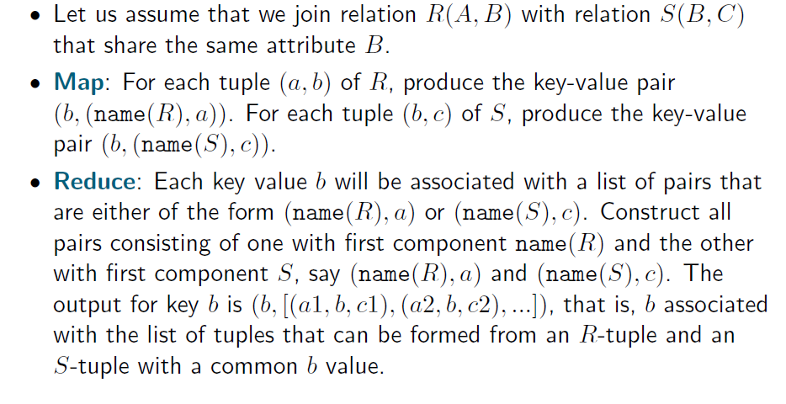
NATURAL JOIN

Slide 29
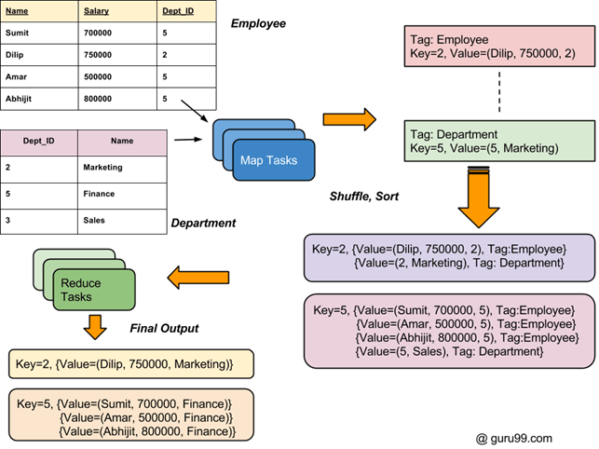

Slide 30
MAP-REDUCE EXAMPLE : JOIN
Select R.A, R.B, S.D where R.A==S.A
 | A | B | C
R1 | 1 | 10 | 12
R2 | 2 | 20 | 34
R3 | 1 | 10 | 22
R4 | 1 | 30 | 56
R5 | 3 | 40 | 17
(1, [R, 10])
(2, [R, 20])
(1, [R, 10])
(1, [R, 30])
(3, [R, 40])
Reducer 1
(1, [(R, 10), (R, 10),
(R, 30), (S, 20)] )
(1, 10, 30)
(1, 10, 30)
(1, 10, 20)
(1, 10, 20)
MAP 1
 | A | D | E
S1 | 1 | 20 | 22
S2 | 2 | 30 | 36
S3 | 2 | 10 | 29
S4 | 3 | 50 | 16
S5 | 3 | 40 | 37
Reducer 2
(1, [S, 20])
(2, [S, 30])
(2, [S, 10])
(3, [S, 50])
(3, [S, 40])
(2, [(R, 20), (S, 30),
(S, 10)] )
(3, [(R, 40), (S, 50),
(S, 40)]
MAP 2
(2, 20, 30)
(2, 20, 10)
(3, 40, 50)
(3, 40, 40)

Slide 31
Natural Join Using Mapreduce
Join R(A,B) with S(B,C) on attribute B
Map:
For each tuple t = (a,b) of R, emit key value pair (b,(R,a))
For each tuple t = (b,c) of S, emit key value pair (b,(S,c))
Reduce:
Each key b would be associated with a list of values that are of the form (R,a) or (S,c)
Construct all pairs consisting of one with first component R and the other with first component S , say (R,a ) and (S,c ). The output from this key and value list is a sequence of key-value pairs
The key is irrelevant. Each value is one of the triples (a, b, c ) such that (R,a ) and (S,c) are on the input list of values
R
A | B
x | a
y | b
z | c
w | d
S
B | C
a | 1
c | 3
d | 4
g | 7

Slide 32
Need For High-level Languages
Hadoop is great for large-data processing!
But writing Java programs for everything is verbose and slow
Analysts don’t want to (or can’t) write Java
Solution: develop higher-level data processing languages
Hive: HQL is like SQL
Pig: Pig Latin is a bit like Perl

Slide 33


HIVE AND PIG
Hive: data warehousing application in Hadoop
Query language is HQL, variant of SQL
Tables stored on HDFS as flat files
Developed by Facebook, now open source
Pig: large-scale data processing system
Scripts are written in Pig Latin, a dataflow language
Developed by Yahoo!, now open source
Roughly 1/3 of all Yahoo! internal jobs
Common idea:
Provide higher-level language to facilitate large-data processing
Higher-level language “compiles down” to Hadoop jobs

Slide 34
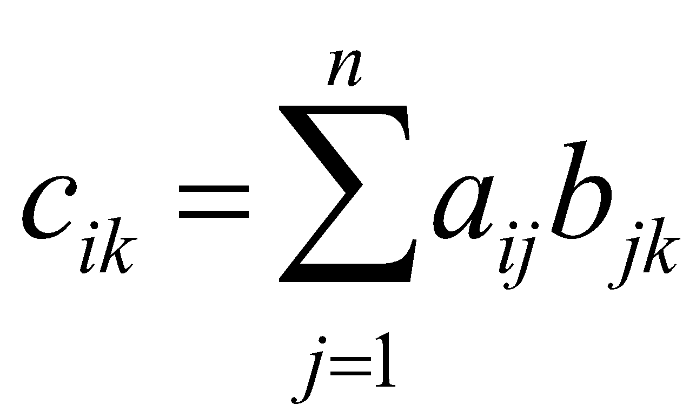
Matrix Multiplication Using Mapreduce 1
A
(m × n)
B
(n × l)
C
(m × l)
n
l
l
m
n
=
m
Think of a matrix as a relation with three attributes
For example matrix A is represented by the relation A(I, J, V)
For every non-zero entry (i, j, a_{ij}), the row number is the value of I, column number is the value of J, the entry is the value in V
Also advantage: usually most large matrices would be sparse, the relation would have less number of entries
The product is ~ a natural join followed by a grouping with aggregation

Slide 35
MATRIX MULTIPLICATION USING MR 2
n
l
l
A
(m × n)
(i, j, a_{ij})
B
(n × l)
(j, k, b_{jk})
C
(m × l)
m
n
=
m
Natural join of (I,J,V) and (J,K,W) 🡪 tuples (i, j, k, a_{ij}, b_{jk})
Map:
For every (i, j, a_{ij}), emit key value pair (j, (A, i, a_{ij}))
For every (j, k, b_{jk}), emit key value pair (j, (B, k, b_{jk}))
Reduce:
for each key j
for each value (A, i, a_{ij}) and (B, k, b_{jk})
produce a key value pair ((i,k),(a_{ij}b_{jk}))

Slide 36
MATRIX MULTIPLICATION USING MR 3
n
l
l
A
(m × n)
(i, j, a_{ij})
B
(n × l)
(j, k, b_{jk})
C
(m × l)
m
n
=
m
First MapReduce process has produced key value pairs ((i,k),(a_{ij}b_{jk}))
Another MapReduce process to group and aggregate
Map: identity, just emit the key value pair ((i,k),(a_{ij}b_{jk}))
Reduce:
for each key (i,k)
produce the sum of the all the values for the key:

Slide 37
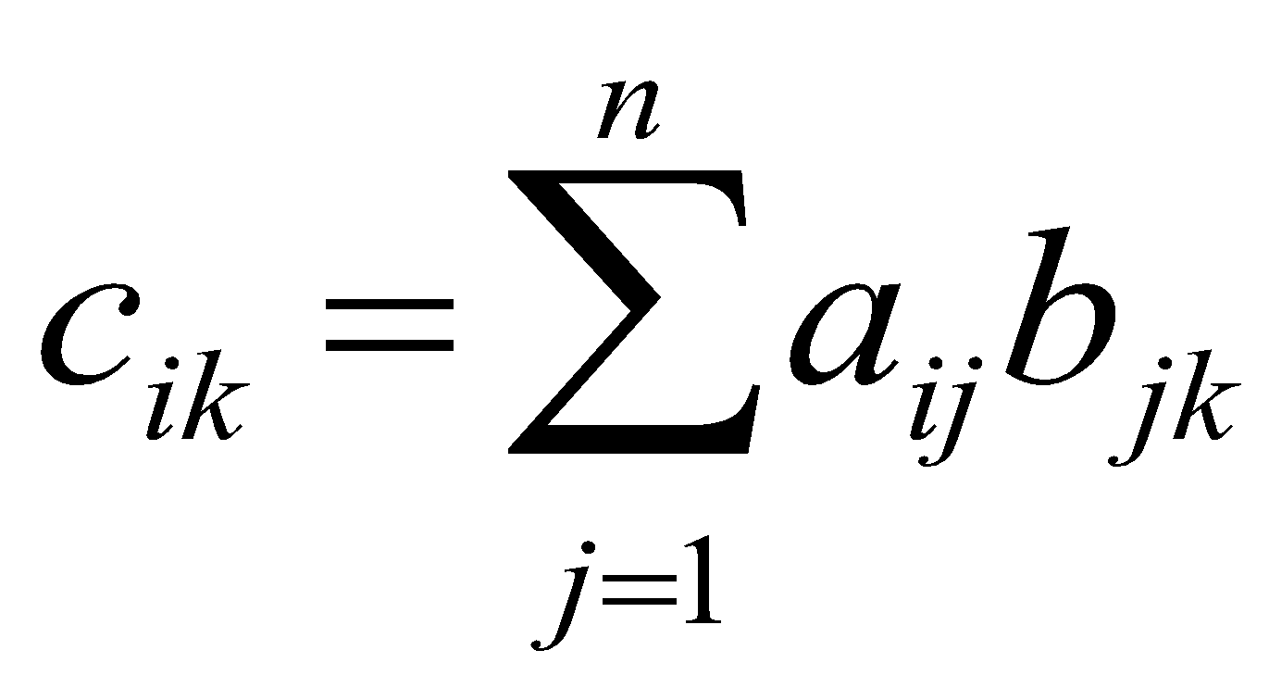
MATRIX MULTIPLICATION USING MAPREDUCE: METHOD 2
n
l
l
A
(m × n)
(i, j, a_{ij})
B
(n × l)
(j, k, b_{jk})
C
(m × l)
m
n
=
m
A method with one MapReduce step
Map:
For every (i, j, a_{ij}), emit for all k = 1,…, l, the key value ((i,k), (A, j, a_{ij}))
For every (j, k, b_{jk}), emit for all i = 1,…, m, the key value ((i,k), (B, j, b_{jk}))
Reduce:
for each key (i,k)
sort values (A, j, a_{ij}) and (B, j, b_{jk}) by j to group them by j
for each j multiply a_{ij} and b_{jk}
sum the products for the key (i,k) to produce
May not fit in main memory. Expensive external sort!

Slide 38
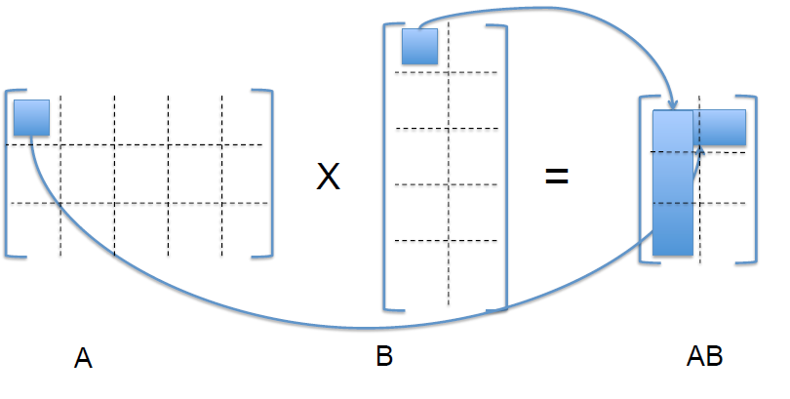
Matrix Multiplication In One Step
One reducer per output cell
Each reducer computes Sum_{j} (A[i,j] * B[j,k])

Slide 39
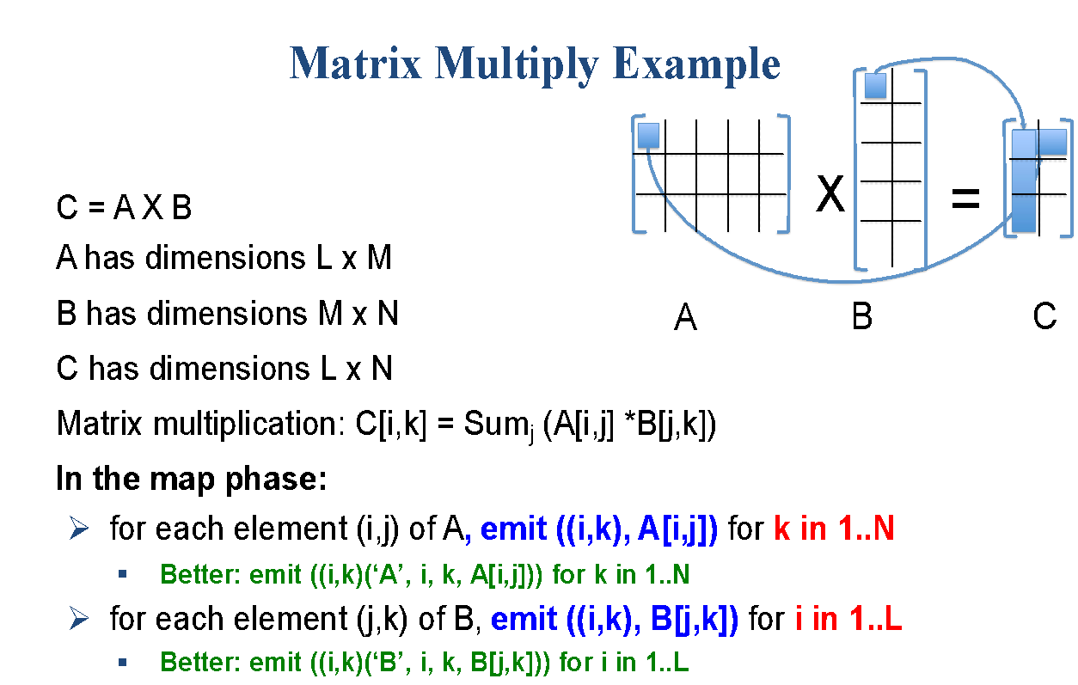
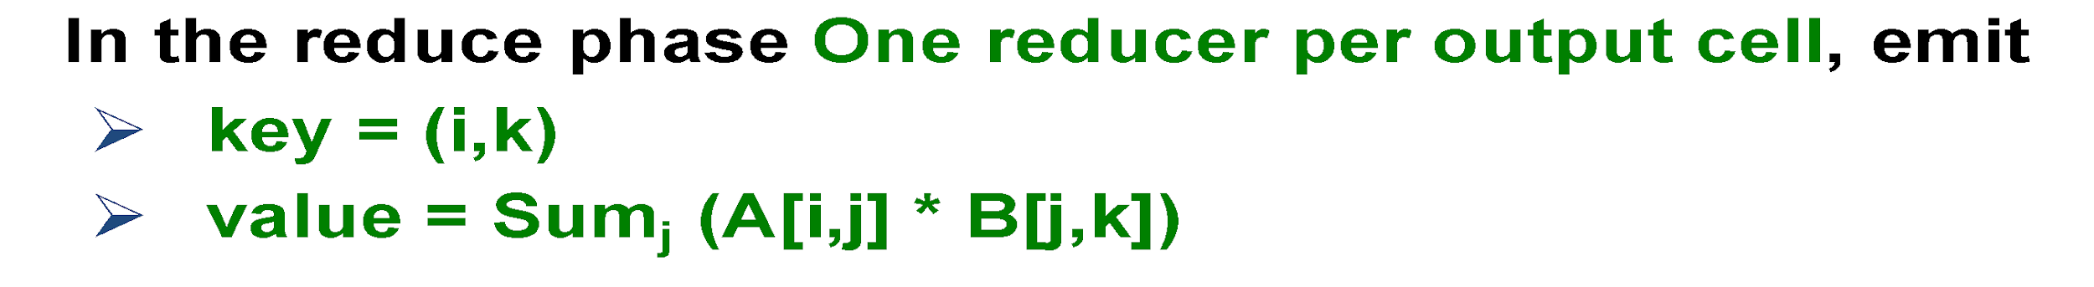

Slide 40
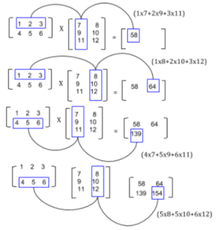
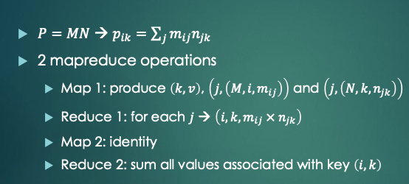
Illustrating Matrix Multiplication

Slide 41
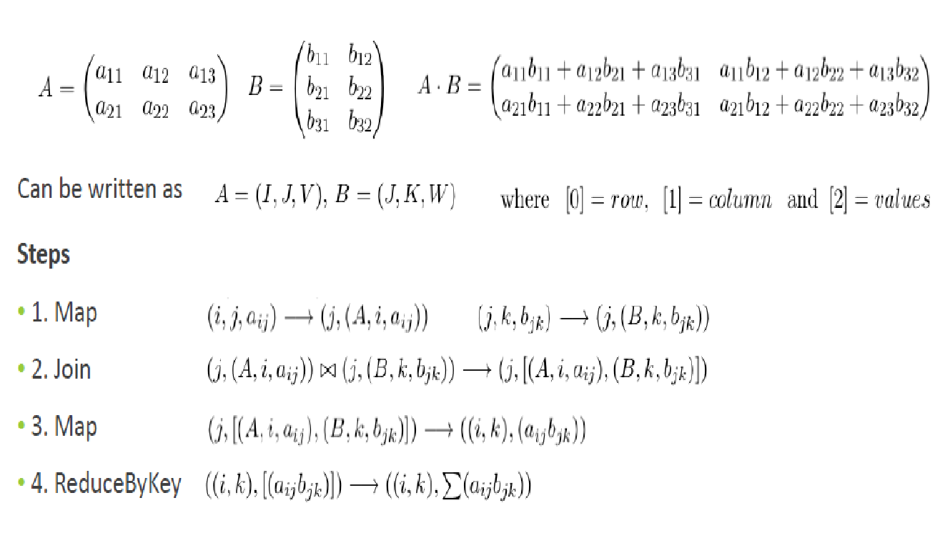

Matrix Multiplication – 2 Phase

Slide 42
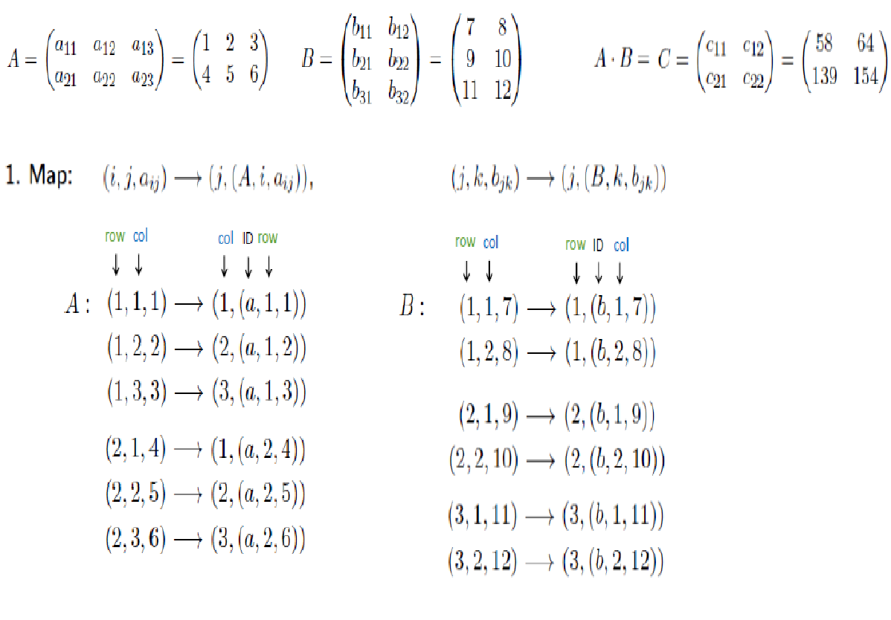

Slide 43
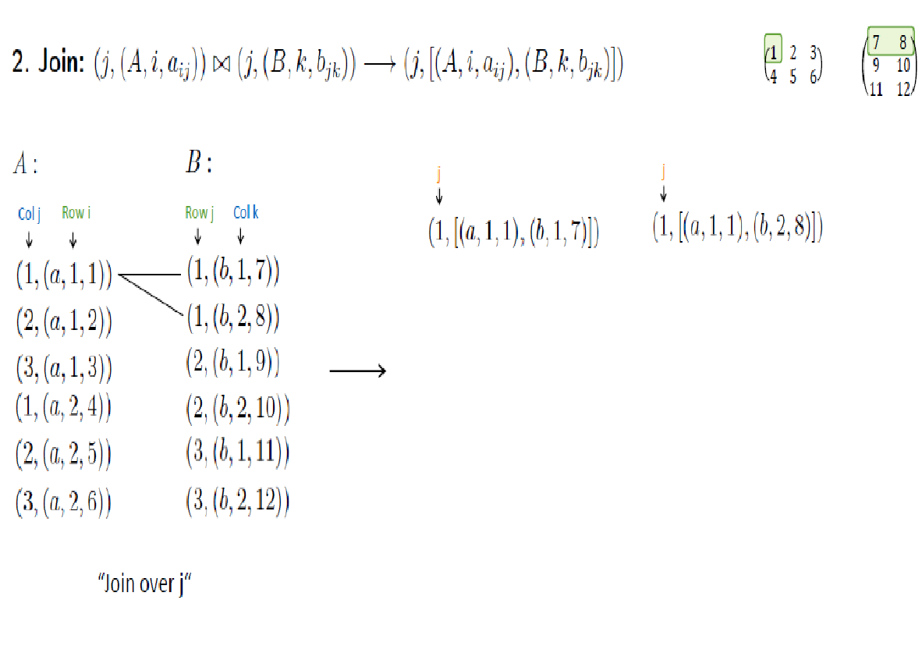

Slide 44
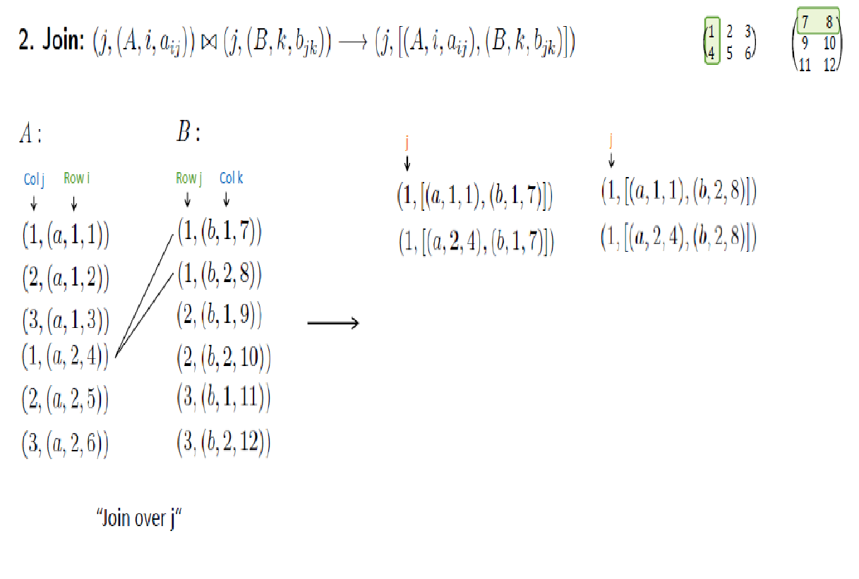

Slide 45
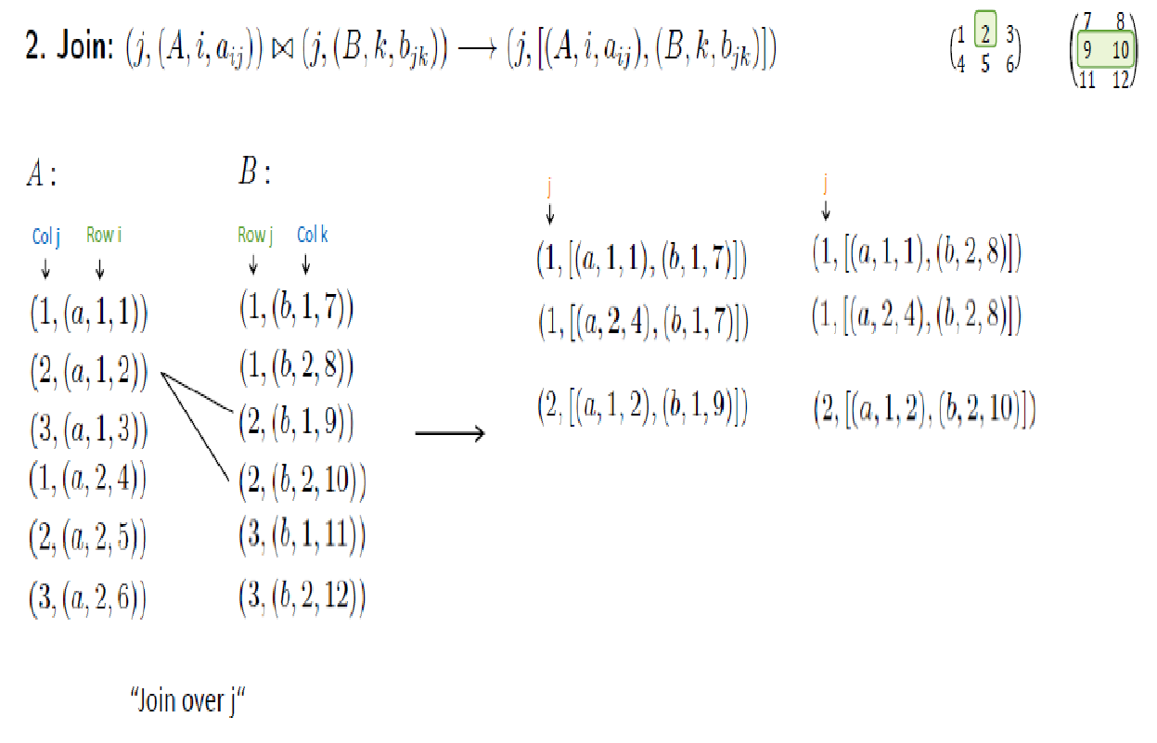

Slide 46
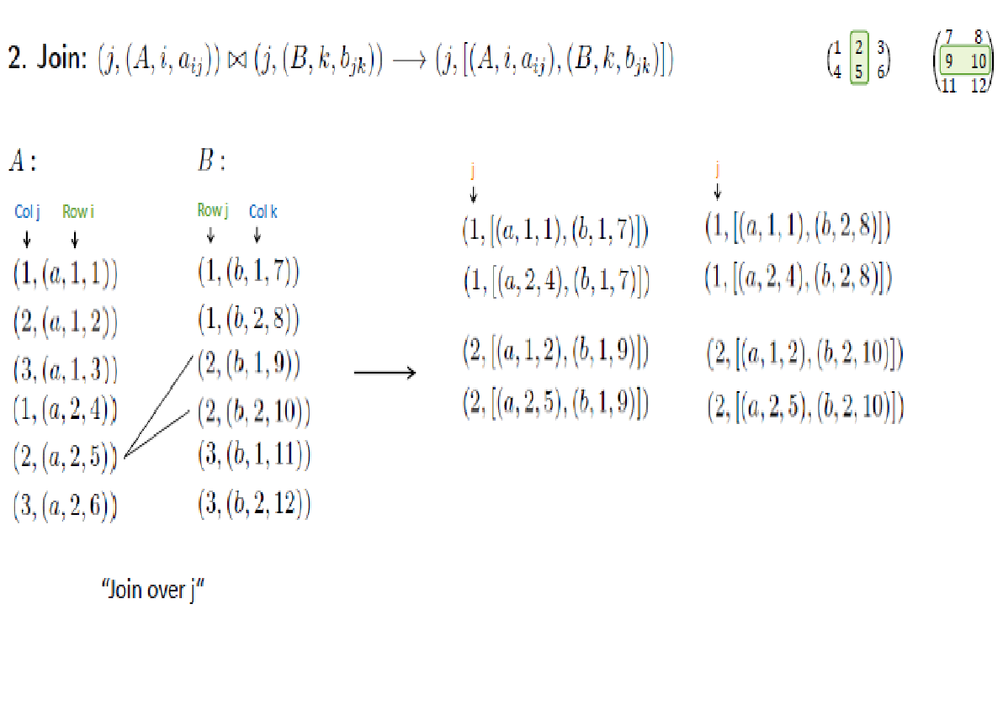

Slide 47
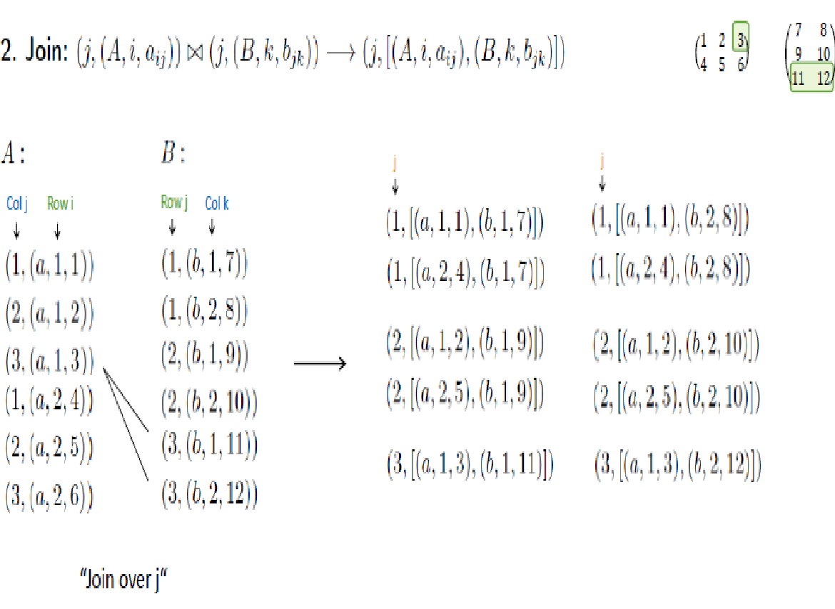

Slide 48
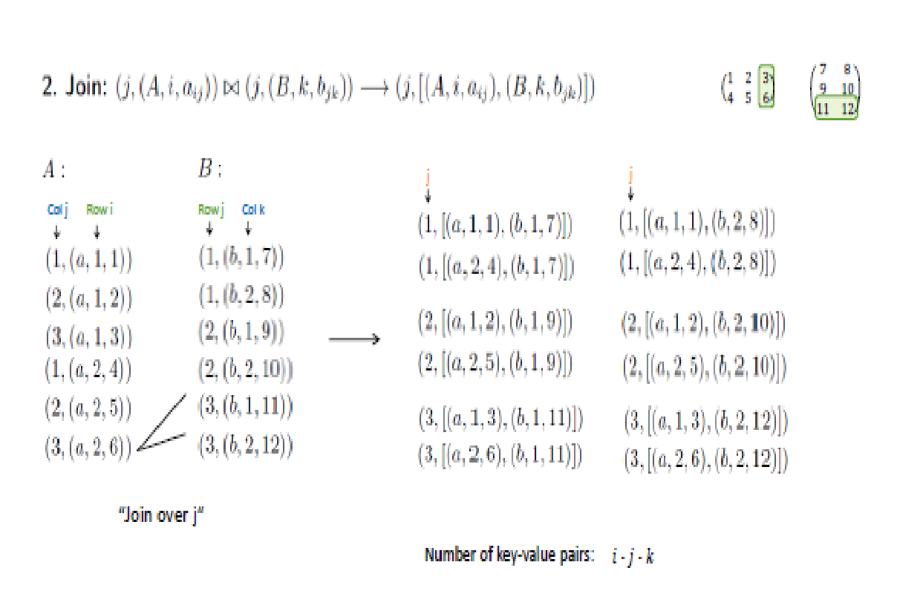

Slide 49
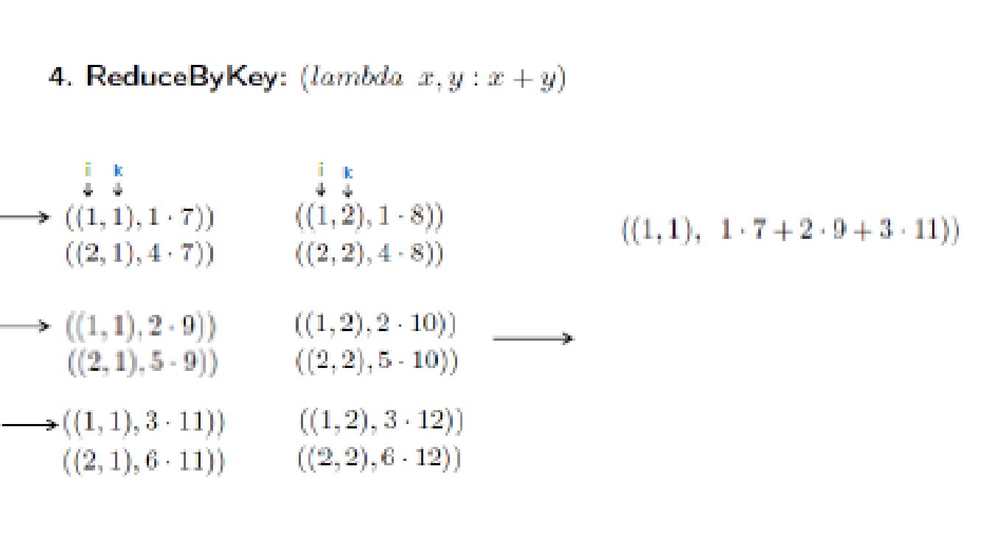
Step 3 Map is just identity – emit (i, k, a_{ik} b_{kj})

Slide 50
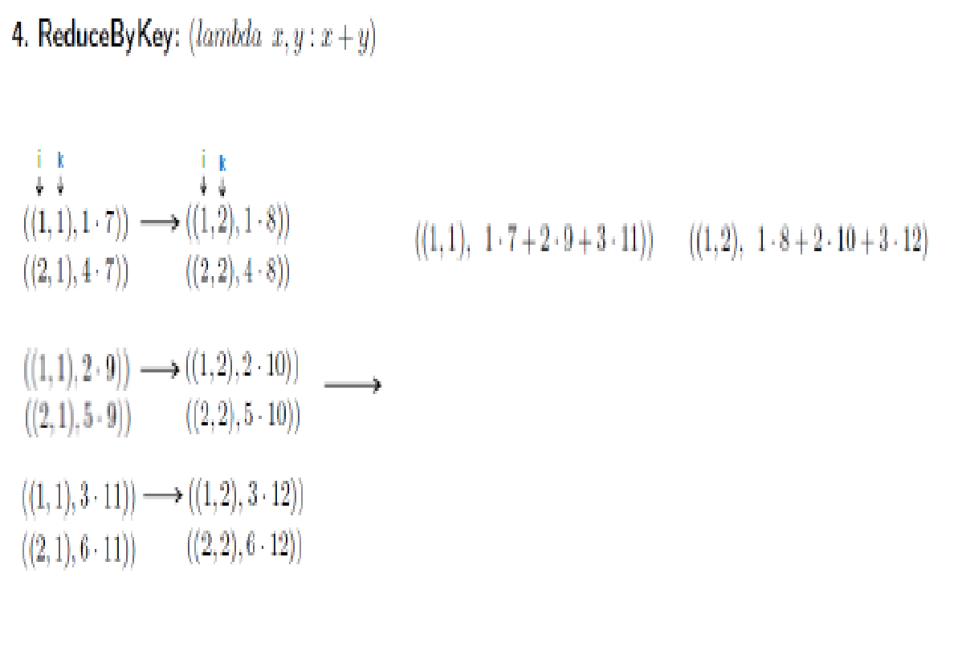

Slide 51
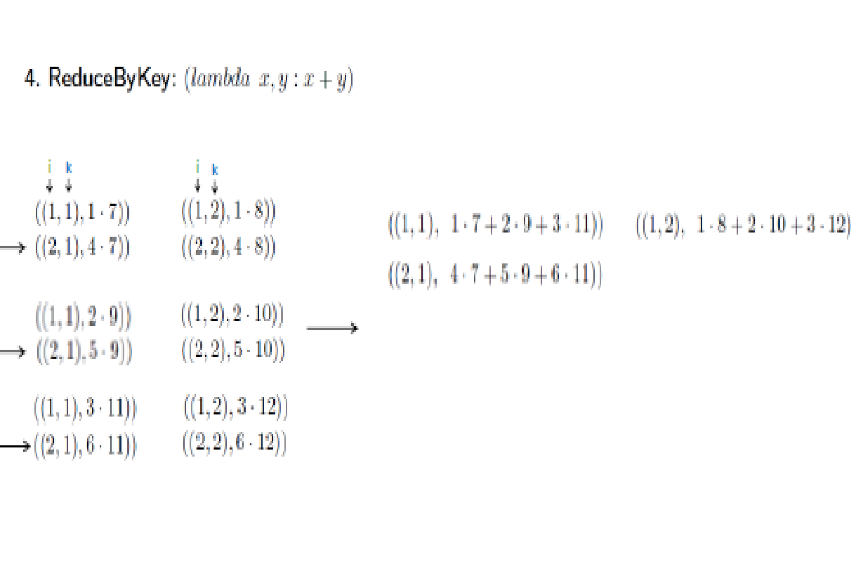

Slide 52
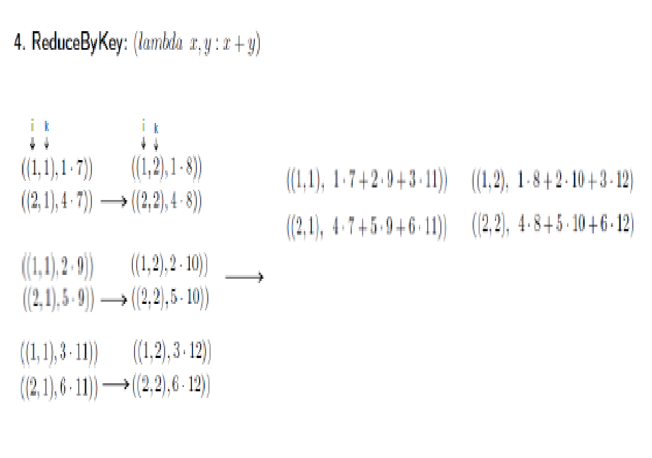

Slide 53
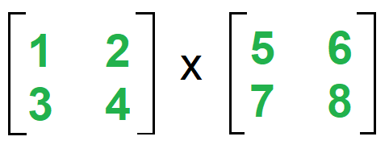
Matrix Multiplication – 1 Phase
Mapper for Matrix A (k, v)=((i, k), (A, j, Aij)) for all k Mapper for Matrix B (k, v)=((i, k), (B, j, Bjk)) for all i
Therefore computing the mapper for Matrix A:
k, i, j computes the number of times it occurs.
Here all are 2, therefore when k=1, i can have 2 values 1 & 2
each case can have 2 further values of j=1 and j=2.
k=1 i=1 j=1 ((1, 1), (A, 1, 1))
j=2 ((1, 1), (A, 2, 2))
i=2 j=1 ((2, 1), (A, 1, 3))
j=2 ((2, 1), (A, 2, 4))
k=2 i=1 j=1 ((1, 2), (A, 1, 1))
j=2 ((1, 2), (A, 2, 2))
i=2 j=1 ((2, 2), (A, 1, 3))
j=2 ((2, 2), (A, 2, 4))

Slide 54
Computing the mapper for Matrix B
i=1 j=1 k=1 ((1, 1), (B, 1, 5))
k=2 ((1, 2), (B, 1, 6))
j=2 k=1 ((1, 1), (B, 2, 7))
k=2 ((1, 2), (B, 2, 8))
i=2 j=1 k=1 ((2, 1), (B, 1, 5))
k=2 ((2, 2), (B, 1, 6))
j=2 k=1 ((2, 1), (B, 2, 7))
k=2 ((2, 2), (B, 2, 8))
The formula for Reducer is:
Reducer (k, v) =(i, k)=>Make sorted Alist and Blist
(i, k) => Summation (Aij * Bjk)) for j
Output =>((i, k), sum)

Slide 55
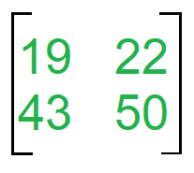
Reducer
Observe from Mapper 4 pairs common (1, 1), (1, 2), (2, 1) and (2, 2)
Separate lists for Matrix A & B with adjoining values from Mapper
(1, 1) =>Alist ={(A, 1, 1), (A, 2, 2)}
Blist ={(B, 1, 5), (B, 2, 7)}
Now Aij x Bjk: [(1*5) + (2*7)] =19 -----(i)
(1, 2) =>Alist ={(A, 1, 1), (A, 2, 2)}
Blist ={(B, 1, 6), (B, 2, 8)}
Now Aij x Bjk: [(1*6) + (2*8)] =22 -----(ii)
(2, 1) =>Alist ={(A, 1, 3), (A, 2, 4)}
Blist ={(B, 1, 5), (B, 2, 7)}
Now Aij x Bjk: [(3*5) + (4*7)] =43 -----(iii)
(2, 2) =>Alist ={(A, 1, 3), (A, 2, 4)}
Blist ={(B, 1, 6), (B, 2, 8)}
Now Aij x Bjk: [(3*6) + (4*8)] =50 ----(iv)
Thus we have
((1, 1), 19)
((1, 2), 22)
((2, 1), 43)
((2, 2), 50)

Slide 56
DISTRIBUTED GREP
Very popular example to explain how Map-Reduce works
Demo program comes with Nutch (where Hadoop originated)

Slide 57
Distributed Grep
For Unix guru: grep -Eh <regex> <inDir>/* | sort | uniq -c | sort -nr - counts lines in all files in <inDir> that match <regex> and displays the counts in descending order - grep -Eh 'A|C' in/* | sort | uniq -c | sort -nr - Analyzing web server access logs to find the top requested pages that match a given pattern
File 1
C
B
B
C
File 2
Result
C
A
3 C
1 A

Slide 58
Distributed Grep
Map function in this case: - input is (file offset, line) - output is either:
1. an empty list [] (the line does not match) 2. a key-value pair [(line, 1)] (if it matches) Reduce function in this case: - input is (line, [1, 1, ...]) - output is (line, n) where n is the number of 1s in the list.

Slide 59
Distributed Grep
File 1
C
B
B
C
File 2
Result
C
A
3 C
1 A
Map tasks: (0, C) -> [(C, 1)] (2, B) -> [] (4, B) -> [] (6, C) -> [(C, 1)] (0, C) -> [(C, 1)] (2, A) -> [(A, 1)]
Reduce tasks: (A, [1]) -> (A, 1) (C, [1, 1, 1]) -> (C, 3)

Slide 60
GEOGRAPHICAL DATA
Large data sets including road, intersection, and feature data
Problems that Google Maps has used MapReduce to solve
Locating roads connected to a given intersection
Rendering of map tiles
Finding nearest feature to a given address or location

Slide 61
GEOGRAPHICAL DATA
Input: List of roads and intersections
Map: Creates pairs of connected points (road, intersection) or (road, road)
Sort: Sort by key
Reduce: Get list of pairs with same key
Output: List of all points that connect to a particular road

Slide 62
GEOGRAPHICAL DATA
Input: Graph describing node network with all gas stations marked
Map: Search five mile radius of each gas station and mark distance to each node
Sort: Sort by key
Reduce: For each node, emit path and gas station with the shortest distance
Output: Graph marked and nearest gas station to each node

Slide 63
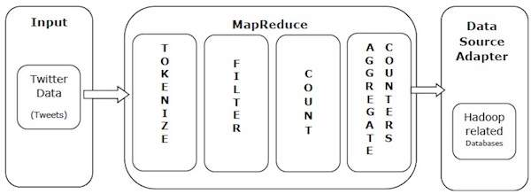
TWITTER ANALYTICS

Slide 64
Let us take a real-world example to comprehend the power of MapReduce. Twitter receives around 500 million tweets per day, which is nearly 3000 tweets per second. The following illustration shows how Tweeter manages its tweets with the help of MapReduce.
As shown in the illustration, the MapReduce algorithm performs the following actions −
Tokenize − Tokenizes the tweets into maps of tokens and writes them as key-value pairs.
Filter − Filters unwanted words from the maps of tokens and writes the filtered maps as key-value pairs.
Count − Generates a token counter per word.
Aggregate Counters − Prepares an aggregate of similar counter values into small manageable units.

Slide 65
MapReduce At FaceBook
Facebook has a list of friends (note that friends are a bi-directional thing on Facebook. If I'm your friend, you're mine).
They also have lots of disk space and they serve hundreds of millions of requests everyday.
They've decided to pre-compute calculations when they can to reduce the processing time of requests.
One common processing request is the "You and XXX have 230 friends in common" feature.
When you visit someone's profile, you see a list of friends that you have in common.
This list doesn't change frequently so it'd be wasteful to recalculate it every time you visited the profile
FaceBook uses mapreduce so that we can calculate everyone's common friends once a day and store those results.
Later on it's just a quick lookup. We've got lots of disk, it's cheap.

Slide 66
MAP REDUCE INAPPLICABILITY
Database management
Sub-optimal implementation for DB
Does not provide traditional DBMS features
Lacks support for default DBMS tools

Slide 67
Map Reduce Inapplicability
Database implementation issues
Lack of a schema
No separation from application program
No indexes
Reliance on brute force

Slide 68
Map Reduce Inapplicability
Feature absence and tool incompatibility
Transaction updates
Changing data and maintaining data integrity
Data mining and replication tools
Database design and construction tools

